Slide 1
Geography:
Important topics/terms for CSS paper

Slide 2
………
Equator
Latitude and Longitude
Prime meridian and International Date Line
Tropic of cancer and tropic of Capricorn
Continents and oceans of the earth
Structure of the earth
Atmosphere
Rocks, earth quakes, volcanoes
Green house effect, and global warming

Slide 3
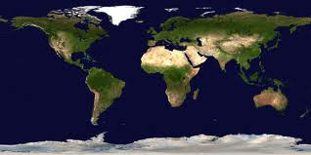

Slide 4
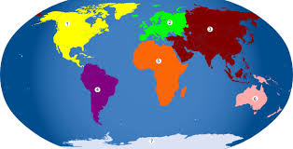

Slide 5
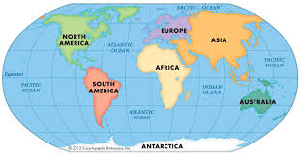

Slide 6
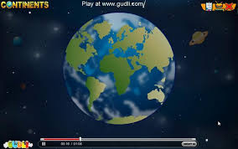

Slide 7
Continent
A continent is one of several major land masses on the earth.
There is no standard definition for the number of continents but you will commonly find that the numbers six or seven are used.
Many consider there to be seven continents - Africa, Antarctica, Asia, Australia, Europe, North America, and South America.
Most students in the United States are taught that there are seven

Slide 8
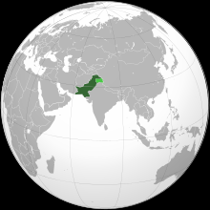
Capital Islamabad
33°40′N 73°10′E

Slide 9
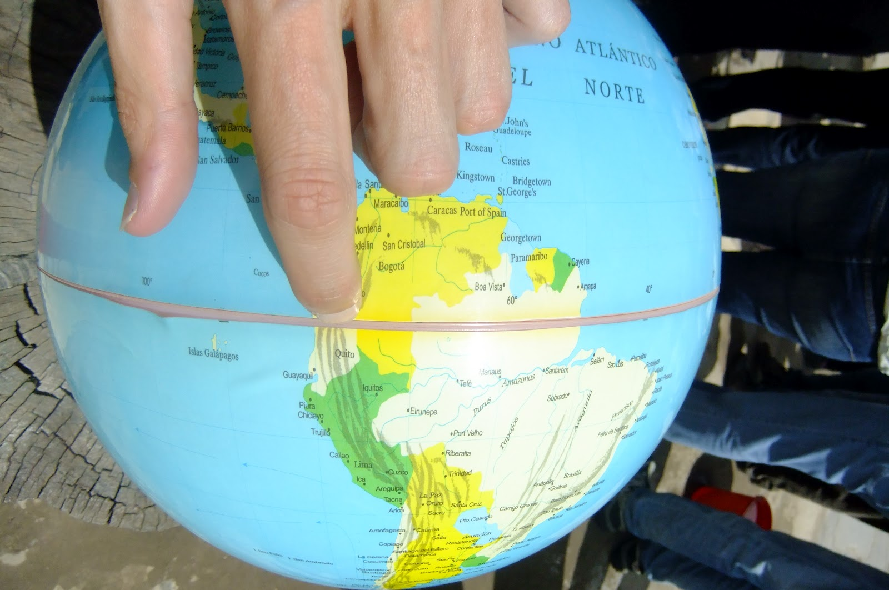

Slide 10
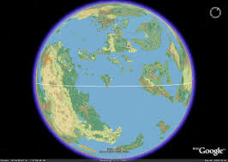

Slide 11
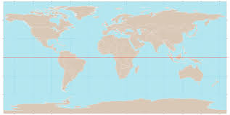

Slide 12
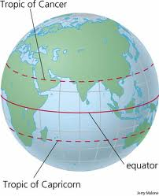

Slide 13
The Equator
The Earth's equator: an imaginary line on the Earth's surface equidistant from the North Pole and South Pole, dividing the Earth into the Northern Hemisphere and Southern Hemisphere.
The equator is located at zero degrees latitude. The equator runs through Indonesia, Ecuador, northern Brazil, the Democratic Republic of the Congo, and Kenya, among other countries.

Slide 14
..continued
It is 24,901.55 miles (40,075.16 kilometers) long.
On the equator, the sun is directly overhead at noon on the two equinoxes - near March and September 21.
The equator divides the planet into the Northern and Southern Hemispheres.
On the equator, the length of day and night are equal every day of the year - day is always twelve hours long and night is always twelve hours long.

Slide 15
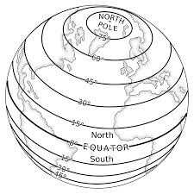

Slide 16
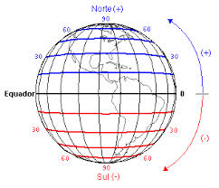

Slide 17
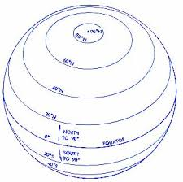

Slide 18
Latitude
1:Latitude is the angular distance of any point on Earth measured north or south of the equator in degrees, minutes and seconds.
2:on a map, these are the lines running horizontally from east-west.
Latitude lines are also sometimes called parallels because they are parallel and equidistant from each other
The equator is a line going around Earth and is halfway between the North and South Poles, it is given a latitude of 0°.

Slide 19
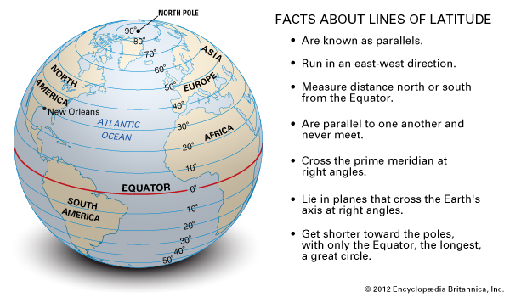

Slide 21
Tropic of Cancer and tropic of Capricorn
The tropics are the two lines where the sun is directly overhead at noon on the two solstices - near June and December 21.
The sun is directly overhead at noon on the Tropic of Cancer on June 21, and the sun is directly overhead at noon on the Tropic of Capricorn on December 21 .

Slide 22
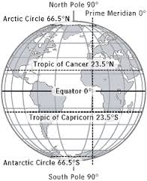

Slide 23
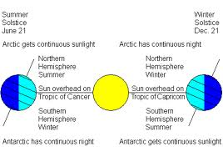

Slide 24
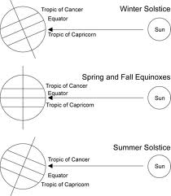

Slide 25
….
The reason for the location of the Tropic of Cancer and the Tropic of Capricorn at 23.5° north and south respectively is due to the axial tilt of the Earth.
The Earth is titled 23.5 degrees from the plane of the Earth's revolution around the sun each year.

Slide 26
….
The area bounded by the Tropic of Cancer on the north and Tropic of Capricorn on the south is known as the "tropics.“
This area does not experience seasons because the sun is always high in the sky.
Only higher latitudes, north of the Tropic of Cancer and south of the Tropic of Capricorn, experience significant seasonal variation in climate.

Slide 27
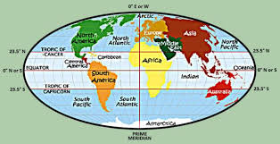

Slide 28
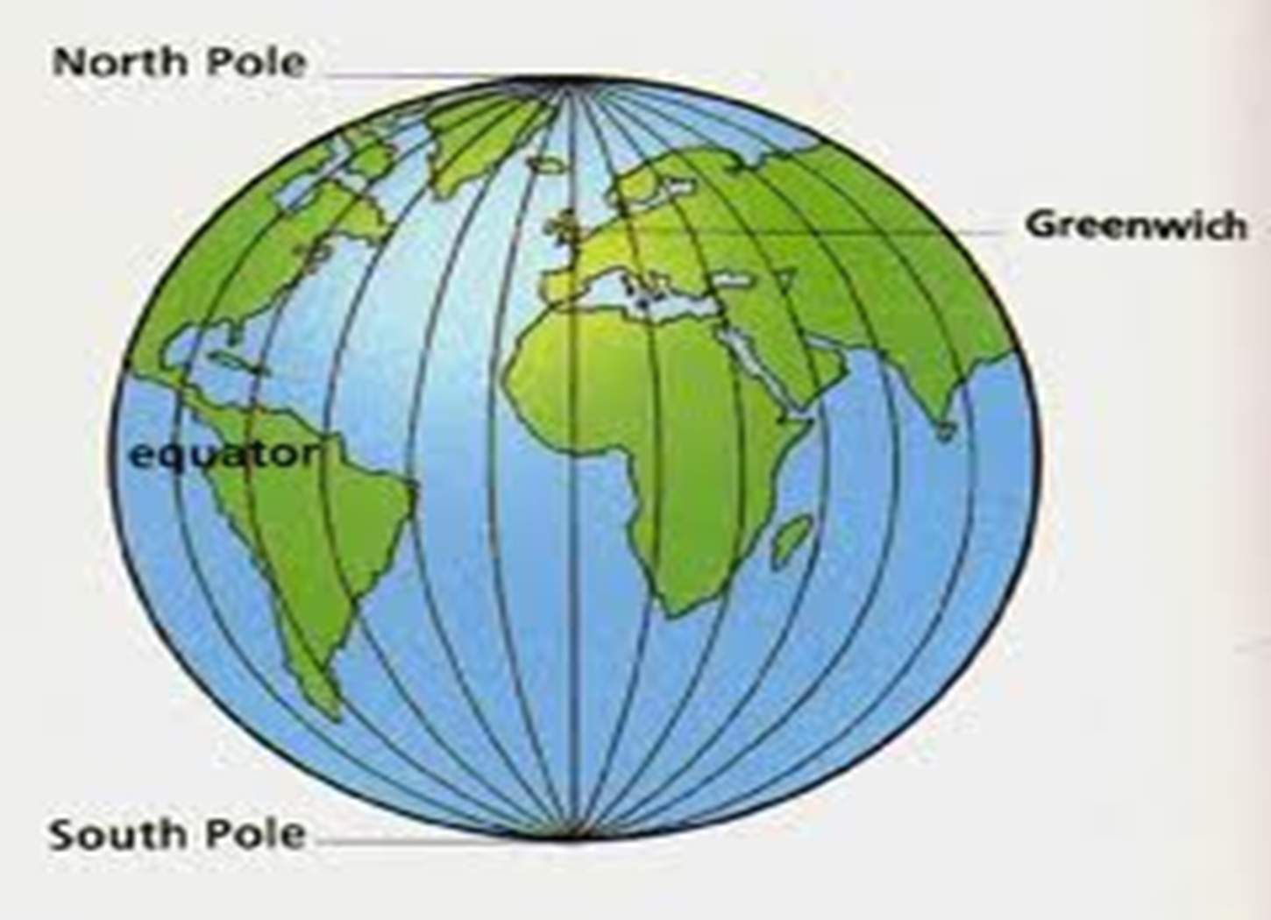

Slide 29
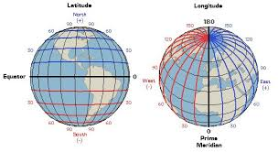

Slide 30
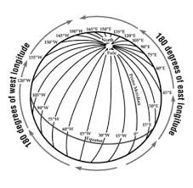

Slide 31
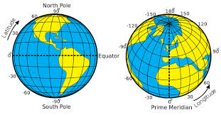

Slide 32
Longitude
1:Longitude is the angular distance of any point on Earth measured east or west of a point on Earth's surface.
2:On a map (diagram), lines of longitude are the vertical lines running from the North Pole to the South Pole and are perpendicular to lines of latitude.
Every line of longitude also crosses the equator. Because longitude lines are not parallel, they are known as meridians.

Slide 33
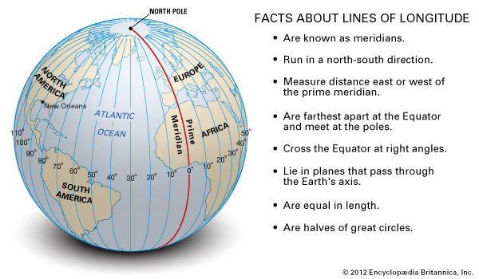

Slide 34
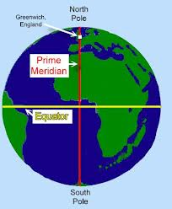

Slide 35
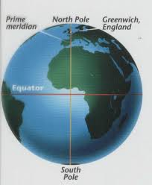

Slide 36
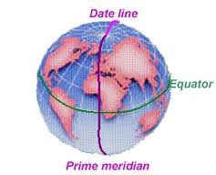

Slide 37
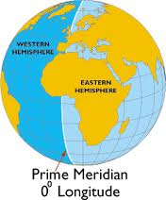

Slide 38
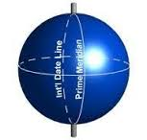

Slide 39
Prime Meridian
The prime meridian is the zero degree line of longitude that passes near London.
The prime meridian was officially established as zero degrees longitude at an international conference in 1884.

Slide 40
….
By establishing the prime meridian and zero degrees longitude in Greenwich, the world was then divided into 24 time zones (since the earth takes 24 hours to revolve on its axis) and thus each time zone was established every fifteen degrees of longitude, for a total of 360 degrees in a circle.

Slide 41
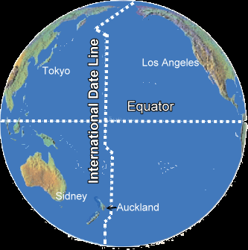

Slide 42
International Date Line
Definition: An imaginary line near 180 degrees longitude that exists to separate the two simultaneous days that exist on the planet that the same time.

Slide 43
International Date Line
The International Date Line is not a straight line, either. Since its beginning, it has zigzagged to avoid spitting apart countries into two days.
Cross the line from the east to the west and a day is added.
Cross from west to the east and a day is subtracted.

Slide 44
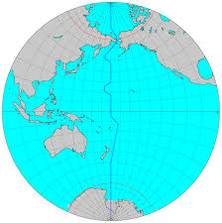

Slide 45
